Slide 1

Rochester Auto Care South
Neighborhood Information Meeting
February 6, 2025, 5:30pm - 6:30pm

Slide 2
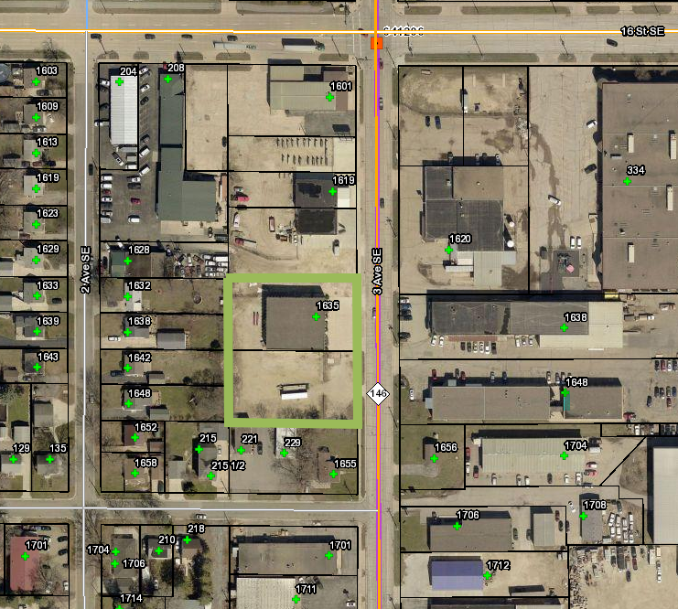
Agenda
  Introductions
  Project Overview
  The Application Process
  Exhibits
    Existing Building
    Site Plan
  Traffic Impacts
  Questions

Slide 3
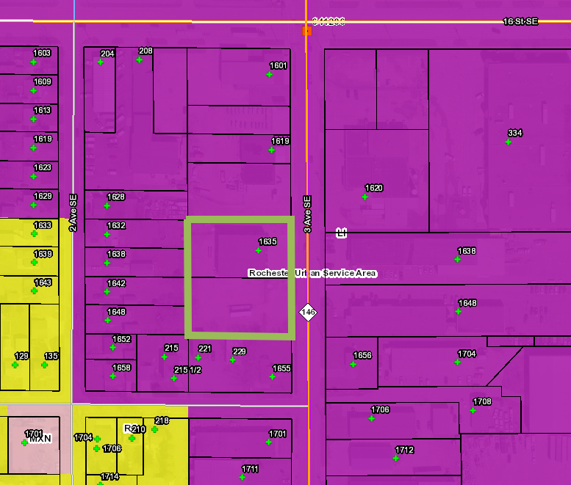
Project Overview
  Located at 1635 3rd Avenue SE
  Site is in the LI (Limited Industrial) zoning district
  Site Contains 2 parcels - totaling 1.00 acre
  Current Use: Vacant Building
  Proposed Use: Auto Sales and Repair
  Existing building will be remodeled and there’s a planned automobile display area on the south end of the property.
  Lot line adjustment

Slide 4
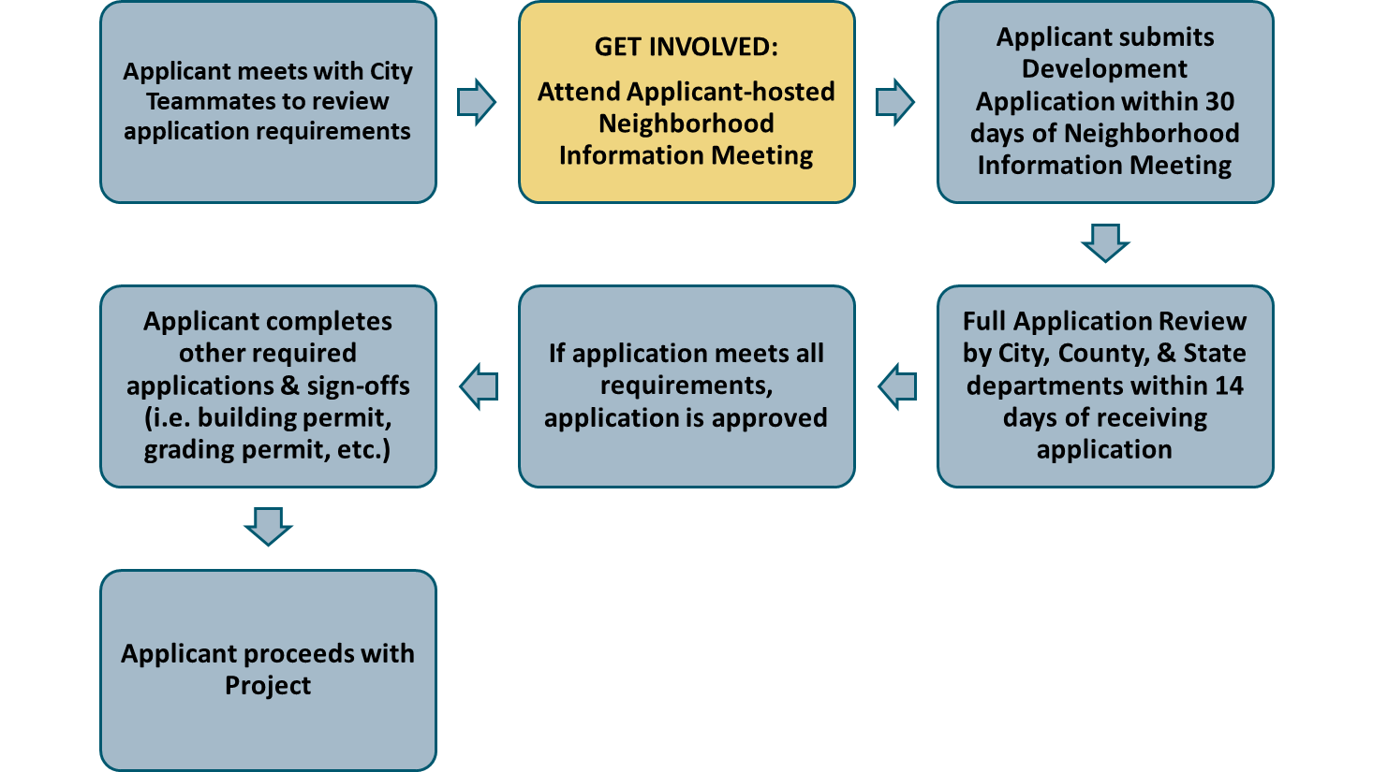
Application Process - SDP

Slide 5
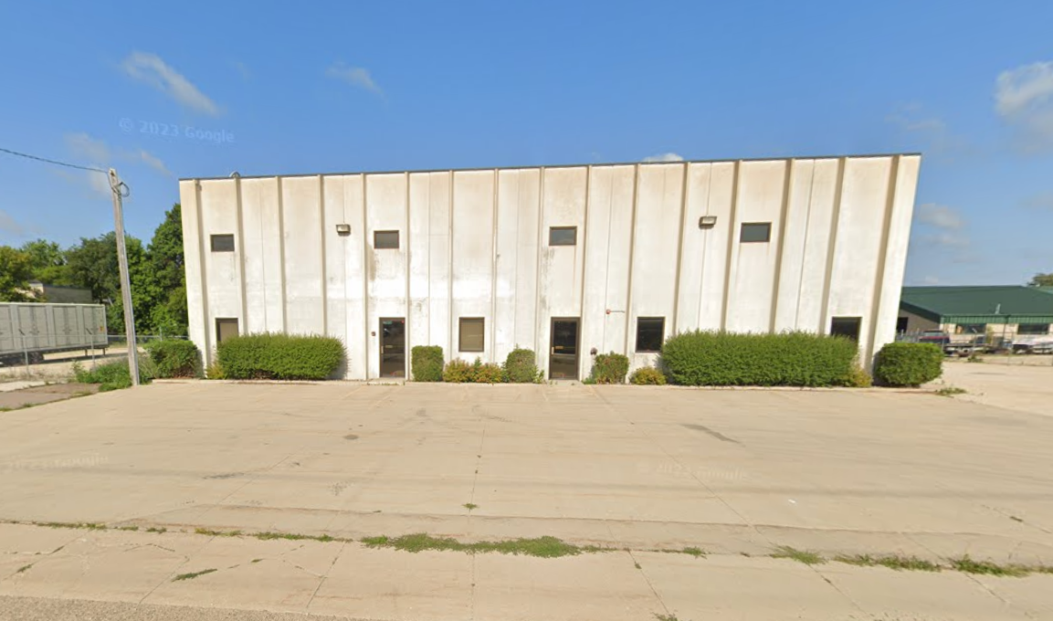
Existing Building
  Existing building footprint to remain the same
  Interior remodel for auto sales and repair

Slide 6
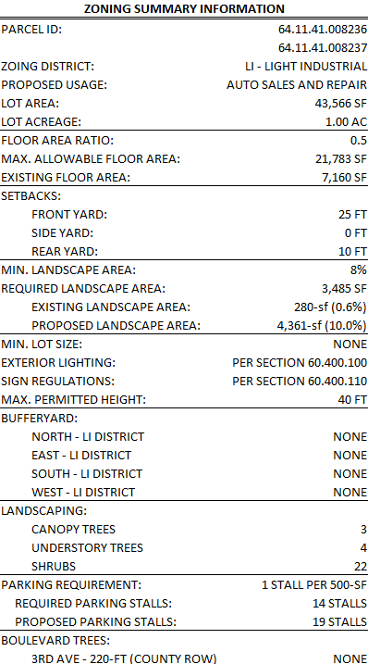
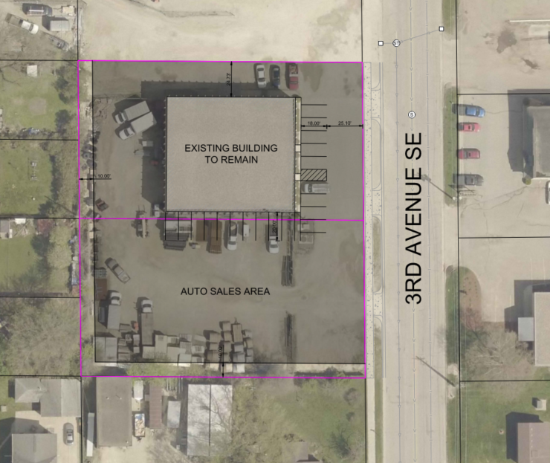
Site Plan

Slide 7
Traffic Impacts
  Existing Conditions:
    Previously Farrell Equipment & Supply Co
      Daily trips – 29
      AM/PM peak hour trips - 7
  Proposed Conditions:
    ITE Use 841 and 943 - Auto Sales and Repair
      Daily trips – 151
      AM/PM peak hour trips – 27

Slide 8


Questions
Contact Information:
  Craig Britton
  507-206-2125
  Craig.Britton@widseth.com

Slide 9
Still Have Questions?
  Contact the City of Rochester’s Community Development Department with any questions about this application type via email communitydevelopment@rochestermn.gov or phone (507-328-2600).

